Slide 1

Percentage Composition

Slide 2

Overview
Percentage composition
Concept
calculations

Slide 3
Percentage Composition
The percentage composition of a compound gives the percentage by mass of each element in the compound.
Break it down:
Compound – means a substance that contains 2 or more different elements
Compounds have fixed ratios of atoms that we represent as the formula, for example iron (III) oxide has a formula of Fe₂O₃
There is a direct relationship between the formula of a compound and its percentage composition

Slide 4
Percentage Composition
Calculations in this area:
Use the compound’s formula to calculate the percentage composition
Find the percentage composition from experimental data
Applied calculation: finding the percentage composition of water in a hydrated compound e.g. NiSO₂.xH₂O find x (we will be doing this in Experiment 17)

Slide 5
Percentage Composition
Use the compound’s formula to calculate the percentage composition
% by mass of an element in a compound =
mass of the element in 1 mol of the compound
molar mass of the compound
x 100
2. find the percentage composition from experimental data
% by mass of an element in a compound =
mass of the element in sample
total mass of the sample
x 100

Slide 6
Percentage Composition
Example 1: Determine the percentage of sodium in sodium carbonate
Step 1: find the molar mass of the compound
M(Na₂CO₃) = 2 x Ar(Na) + Ar(C) + 3 x Ar (O)
= (2 x 22.99) + 12.01 + (3 x 16.00)
= 105.99 g mol⁻¹
Step 2: find total mass of the element in 1 mole of the compound
mass of Na in 1 mol = 2 x M(Na)
= 2 x 22.99 = 45.98 g
Step 3: find the percentage by mass of the element in the compound
% by mass of Na in Na₂CO₃ =
mass of the element in 1 mol of the compound
molar mass of the compound
x 100
45.98
105.99
=
x 100
= 43.38 %

Slide 7
Calculation Practice 1
In WA, the export of iron ore is vital to our economy. To be profitable a company needs to be able to calculate how much iron, by mass, can be extracted from certain types of ore. Find the percentage composition of iron in an ore that has the formula Fe₂O₃.

Slide 8
Calculation Practice 1
***STOP***
Make sure you have written the answer to the question in your science book before clicking to the next slide.

Slide 9
Calculation Practice 1
In WA, the export of iron ore is vital to our economy. To be profitable a company needs to be able to calculate how much iron, by mass, can be extracted from certain types of ore. Find the percentage composition of iron in an ore that has the formula Fe₂O₃.
M(Fe₂O₃) = 2 x 55.85 + 3 x 16.00
= 159.7 g mol⁻¹
% by mass of Fe in Fe₂O₃ =
mass of the element in 1 mol of the compound
molar mass of the compound
x 100
mass Fe in 1 mol = 2 x M(Fe)
= 2 x 55.85
= 111.7 g
111.7
159.7
=
x 100
= 69.9 %
The ore contains 69.9 % iron by mass

Slide 10
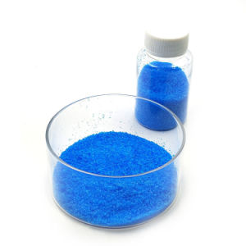
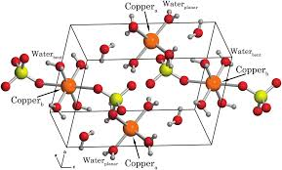
Percentage Composition
Water of crystallization: some solid compounds contain water within the crystal structure. A hydrated formula shows the number of water molecules per molecule or formula unit of the compound.
E.g. CuSO₄.5H₂O (name: copper sulfate-5-water or copper sulfate pentahydrate)

Slide 11
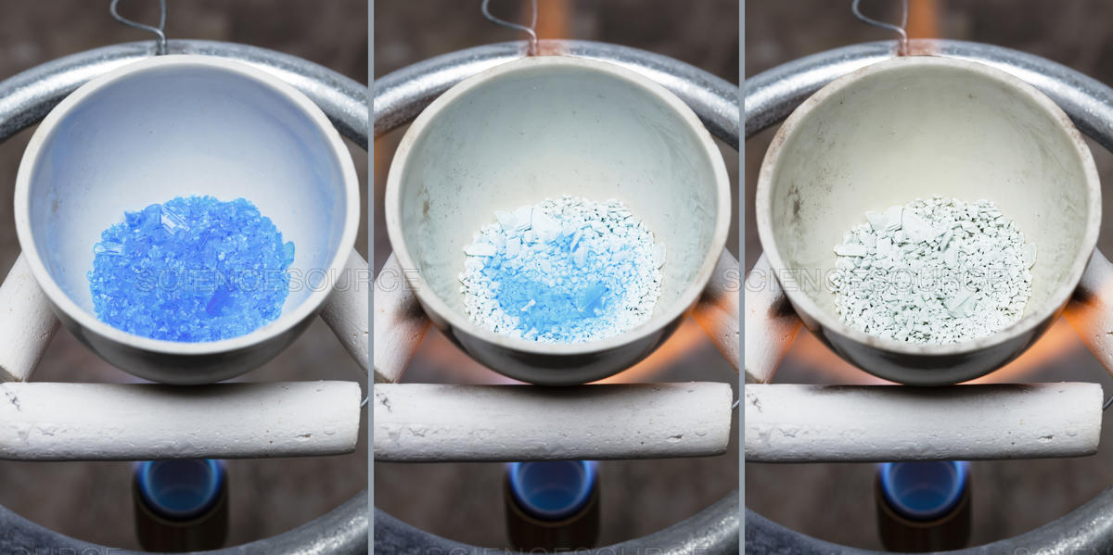
Percentage Composition
If we gently heat the sample of copper sulfate-5-water, we drive off the water of crystallization. The resulting substance, copper sulfate, is a white powder (seen in the picture on far right)
Calculate the percentage of water, by mass, in copper sulfate-5-water.
M(H₂O) = (2 x 1.008) + 16.00
= 18.016 g mol⁻¹
M(CuSO₄.5H₂O) = 63.55 + 32.07 +
(4 x 16.00) + (5 x 18.016)
= 249.70 g mol⁻¹
mass of water in 1 mol of the compound
molar mass of the compound
% H₂O =
x 100
=
5 x 18.016
249.70
x 100
= 36.08 % water by mass in copper sulfate-5-water

Slide 12
Percentage Composition – Ongoing work
Take notes in your Science book on Pearson ch 9.4
Compete Pearson ch 9.4 review and the Chapter 9 final review
Complete STAWA Set 25 all questions

